Slide 1
Hibernate Mapping
Dessign by: DieuNT1

Slide 2
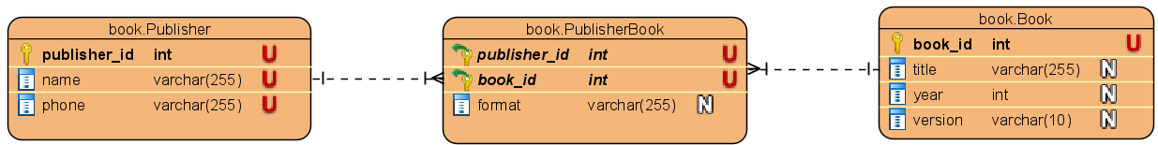
Many-to-Many Mapping Annotation @EmbeddedId and @MapsId
Map a many-to-many association with extra columns.
Many-to-Many Using a Composite Key
Note, that there’re some key requirements, which a composite key class has to fulfill:
We have to mark it with @Embeddable
It has to implement java.io.Serializable
We need to provide an implementation of the hashcode() and equals() methods
None of the fields can be an entity themselves.

Slide 3
Many-to-Many Mapping Annotation @EmbeddedId and @MapsId
Create a class that contains the id of Publisher_Book table.
Implement the Serializable interface and the attributes bookId and publisherId.
@Embeddable
public class PublisherBookId implements Serializable {
private static final long serialVersionUID = 1L;
private int publisherId;
private int bookId;
// getter and setter method
//
@Override
public int hashCode(){}
@Override
public boolean equals(Object obj) {}
}

Slide 4
Many-to-Many Mapping Annotation @EmbeddedId and @MapsId
You need to model the Publisher_Book table as an entity with 2 many-to-one relationships to the Publisher and Book entities.
@Entity
@Table(name = "Publisher_Book", schema = "book")
public class PublisherBook {
@EmbeddedId
private PublisherBookId id;
@ManyToOne
@MapsId(value = "publisherId")
private Publisher publisher;
@ManyToOne
@MapsId(value = "bookId")
private Book book;
private String format;
// getter and setter methods
}

Slide 5
Many-to-Many Mapping Annotation @EmbeddedId and @MapsId
And if you want to map them as bidirectional associations, you need to model the referencing side of the association on the Book and Publisher entity.
@Entity
@Table(name = "Publisher", schema = "book")
public class Publisher {
@Id
@GeneratedValue(strategy = GenerationType.IDENTITY)
@Column(name = "publisher_id")
private int publisherId;
@Column(unique = true)
private String name;
@Column(unique = true)
private String phone;
@OneToMany(cascade = CascadeType.ALL, mappedBy = "publisher")
private Set<PublisherBook> publisherBook;
// getter and setter methods
}

Slide 6
Many-to-Many Mapping Annotation @EmbeddedId and @MapsId
And if you want to map them as bidirectional associations, you need to model the referencing side of the association on the Book and Publisher entity.
Entity
@Table(name = "Book", schema = "book")
public class Book {
@Id
@GeneratedValue(strategy = GenerationType.IDENTITY)
@Column(name = "book_id")
private int bookId;
@Column(unique = true)
private String title;
private int year;
@Column(length = 10)
private String version;
@OneToMany(cascade = CascadeType.ALL, mappedBy = "book")
private Set<PublisherBook> publisherBook;
// getter and setter methods
}

Slide 7
Many-to-Many Mapping Annotation @EmbeddedId and @MapsId
Create a Test Script to check.
Assuming that you have implemented the BookDao, PublisherDao as the DAO classes mentioned above.
class PublisherBookDaoTest {
static PublisherBookDao publisherBookDao;
static BookDao bookDao;
static PublisherDao publisherDao;
@BeforeAll
static void setUpBeforeClass() throws Exception {
publisherBookDao = new PublisherBookDaoImpl();
bookDao = new BookDaoImpl();
publisherDao = new PublisherDaoImpl();
}

Slide 8
Many-to-Many Mapping Annotation @EmbeddedId and @MapsId
@Test
void testSave() throws Exception {
Book book = new Book(1, "Java SE", 2020, "1.0");
assertTrue(bookDao.save(book));
Publisher publisher = new Publisher(1, "NXB GD", "0979867234");
assertTrue(publisherDao.save(publisher));
PublisherBookId id = new PublisherBookId(1, 1);
PublisherBook publisherBook = new PublisherBook();
publisherBook.setId(id);
publisherBook.setFormat("ABC");
publisherBook.setBook(book);
publisherBook.setPublisher(publisher);
assertTrue(publisherBookDao.save(publisherBook));
}
}

Slide 9
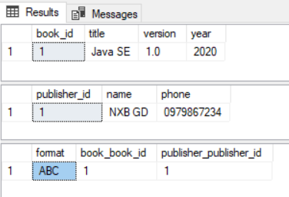
Many-to-Many Mapping Annotation @EmbeddedId and @MapsId
Results:
Console:
Hibernate: create table book.Book (book_id int identity not null, title varchar(255), version varchar(10), year int not null, primary key (book_id))
Hibernate: create table book.Publisher (publisher_id int identity not null, name varchar(255), phone varchar(255), primary key (publisher_id))
Hibernate: create table book.Publisher_Book (format varchar(255), book_book_id int not null, publisher_publisher_id int not null, primary key (book_book_id, publisher_publisher_id))
Hibernate: alter table book.Book drop constraint UK_odppys65lq7q1xbx8o6p6fgxj
Hibernate: alter table book.Book add constraint UK_odppys65lq7q1xbx8o6p6fgxj unique (title)
Hibernate: alter table book.Publisher drop constraint UK_era79tsdasvick3e38j0e9b6v
Hibernate: alter table book.Publisher add constraint UK_era79tsdasvick3e38j0e9b6v unique (name)
Hibernate: alter table book.Publisher drop constraint UK_lfeio9fee753ckef2tac2vfku
Hibernate: alter table book.Publisher add constraint UK_lfeio9fee753ckef2tac2vfku unique (phone)
Hibernate: alter table book.Publisher_Book add constraint FKa0gwplfbh13yt8flgvc9yw5k6 foreign key (book_book_id) references book.Book
Hibernate: alter table book.Publisher_Book add constraint FKkxs5ufy7sipi1me6hc2d7ksst foreign key (publisher_publisher_id) references book.Publisher
Oct 11, 2020 3:27:11 PM org.hibernate.engine.transaction.jta.platform.internal.JtaPlatformInitiator initiateService
INFO: HHH000490: Using JtaPlatform implementation: [org.hibernate.engine.transaction.jta.platform.internal.NoJtaPlatform]
Hibernate: insert into book.Book (title, version, year) values (?, ?, ?)
Hibernate: insert into book.Publisher (name, phone) values (?, ?)
Hibernate: insert into book.Publisher_Book (format, book_book_id, publisher_publisher_id) values (?, ?, ?)

Slide 10
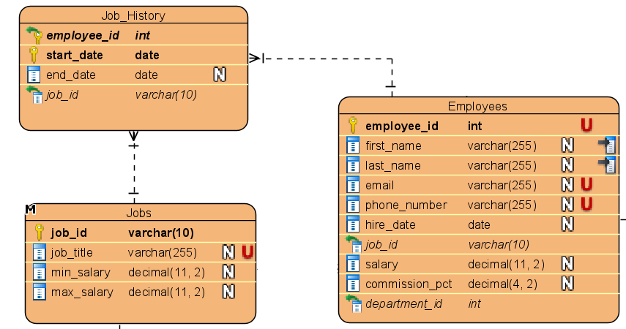
Many-to-Many Mapping Annotation @EmbeddedId and @AssociationOverride
Map a many-to-many association with extra columns.
Many-to-Many Using a Composite Key
Note, that there’re some key requirements, which a composite key class has to fulfill:
We have to mark it with @Embeddable
It has to implement java.io.Serializable
We need to provide an implementation of the hashcode() and equals() methods
None of the fields can be an entity themselves.

Slide 11
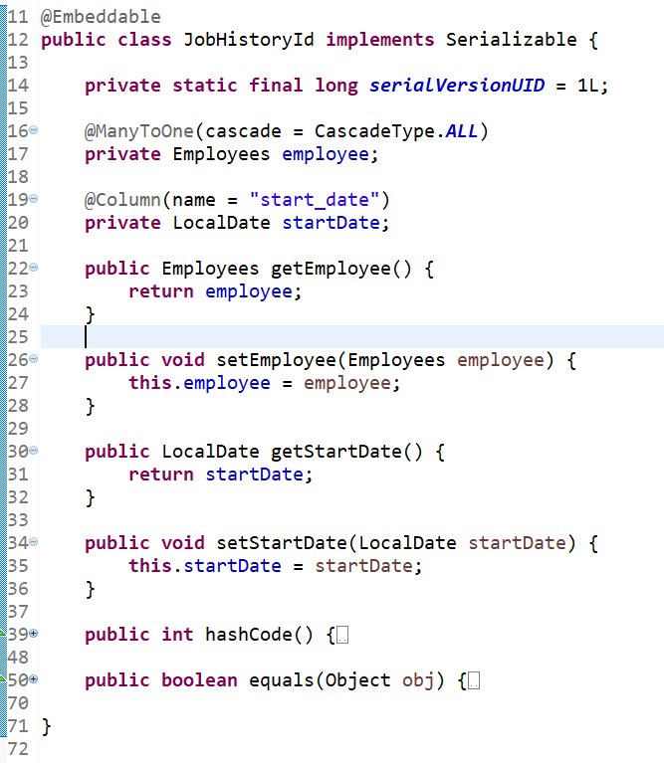
Many-to-Many Mapping Annotation @EmbeddedId and @AssociationOverride

Slide 12
Many-to-Many Mapping Annotation @EmbeddedId and @AssociationOverride
@Entity
@Table(name = "Job_History", schema = "dbo")
@AssociationOverride(name="id.employee", joinColumns=@JoinColumn(name="employee_id"))
public class JobHistory {
@EmbeddedId
private JobHistoryId id;
// extra fields
@Column(name = "end_date")
private LocalDate endDate;
@ManyToOne(fetch = FetchType.LAZY)
@JoinColumn(name = "job_id")
private Jobs job;
@Transient
public Employees getEmployees() {
return getId().getEmployee();
}
public void setEmployees(Employees employee) {
getId().setEmployee(employee);
}
// getter and setter methods
}

Slide 13
Many-to-Many Mapping Annotation @EmbeddedId and @AssociationOverride
Update Jobs class and add the following declaration:
Update Employees class add the following declaration:
@OneToMany(cascade = CascadeType.ALL, mappedBy = "job")
private Set<JobHistory> histories;
@OneToMany(mappedBy = "id.employee", cascade = CascadeType.ALL)
private Set<JobHistory> jobHistory;

Slide 14
Many-to-Many Mapping Annotation @EmbeddedId and @AssociationOverride
Create JobHistoryDaoImpl class:
public class JobHistoryDaoImpl implements JobHistoryDao {
@Override
public boolean save(JobHistory jobHistory) throws Exception {
Session session = null;
Transaction transaction = null;
try {
session = HibernateUtils.getSessionFactory().openSession();
transaction = session.beginTransaction();
Serializable result = session.save(jobHistory);
transaction.commit();
return (result != null);
} finally {
if (session != null) {
session.close();
}
}
}
}

Slide 15
Many-to-Many Mapping Annotation @EmbeddedId and @AssociationOverride
Create a Test Script to test method of JobHistoryDaoImpl:
class JobHistoryDaoTest {
static JobHistoryDao jhDao;
@BeforeAll
static void setUpBeforeClass() throws Exception {
jhDao = new JobHistoryDaoImpl();
}
@Test
void testSave() throws Exception {
JobHistory jobHistory = new JobHistory();
JobHistoryId id = new JobHistoryId();
id.setEmployee(new Employees(1));
id.setStartDate(LocalDate.of(2020, 1, 1));
jobHistory.setId(id);
jobHistory.setEndDate(LocalDate.of(2020, 12, 31));
jobHistory.setJob(new Jobs("J01"));
assertTrue(jhDao.save(jobHistory));
}
}

Slide 16

Many-to-Many Mapping Annotation @EmbeddedId and @AssociationOverride
Results:
Console:
Hibernate: create table dbo.Job_History (start_date date not null, end_date date, employee_id int not null, job_id varchar(10), primary key (employee_id, start_date))
Hibernate: alter table dbo.Job_History add constraint FKsrit9doy1c3hl0g01ju48x6tn foreign key (employee_id) references dbo.Employees
Hibernate: alter table dbo.Job_History add constraint FK5fypfedbeoadd5lo3uo5yet26 foreign key (job_id) references dbo.Jobs
Oct 11, 2020 2:14:26 PM org.hibernate.engine.transaction.jta.platform.internal.JtaPlatformInitiator initiateService
INFO: HHH000490: Using JtaPlatform implementation: [org.hibernate.engine.transaction.jta.platform.internal.NoJtaPlatform]
Hibernate: select jobs_.job_id, jobs_.job_title as job_titl2_4_, jobs_.max_salary as max_sala3_4_,
jobs_.min_salary as min_sala4_4_ from dbo.Jobs jobs_ where jobs_.job_id=?
Hibernate: insert into dbo.Job_History (end_date, job_id, employee_id, start_date) values (?, ?, ?, ?)

Slide 17

Thank you!
Q&A
17

